Slide 1
Safety Problem Statement
Done by:
P1935433, Kok Yong Hsien, DIT/FT/ 2B/12 (Leader)
P1935970 Cheok Zi Hin, DIT/FT/ 2B/12
P1936207, Emily Lim Xiang Qin, DIT/FT/ 2B/13

Slide 2
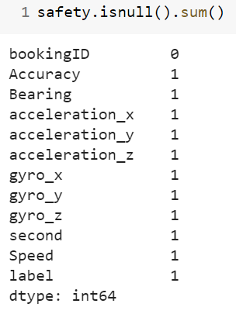
Exploratory Data Analysis
Find out if there are any null values and use forward fill if any

Slide 3
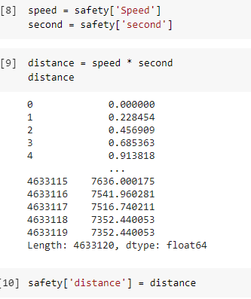
Feature Engineering
Feature distance

Slide 4
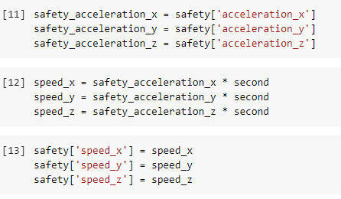
Feature Engineering
Feature speed_x
Feature speed_y
Feature speed_z

Slide 5
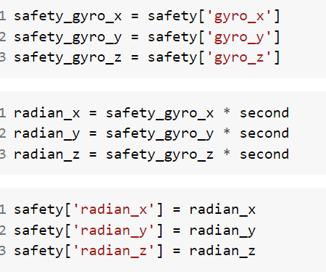
Feature Engineering
Feature radian

Slide 6
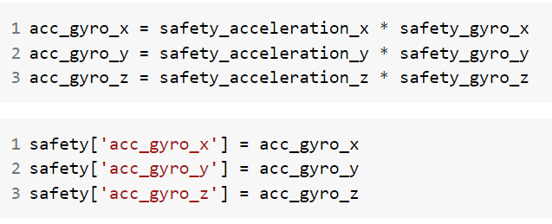
Feature Engineering
Making axis interaction

Slide 7
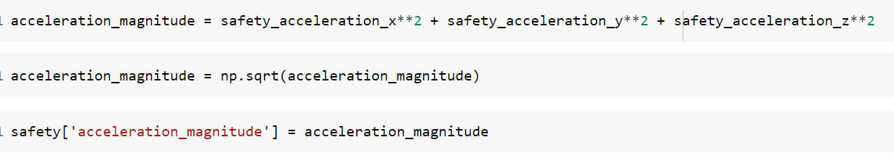
Feature Engineering
Transform the accelerometer data

Slide 8
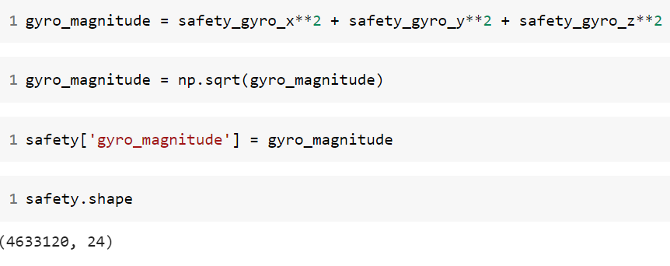
Feature Engineering
Transform the gyroscope data

Slide 9
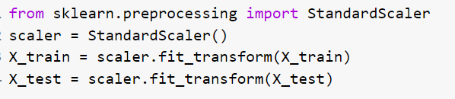
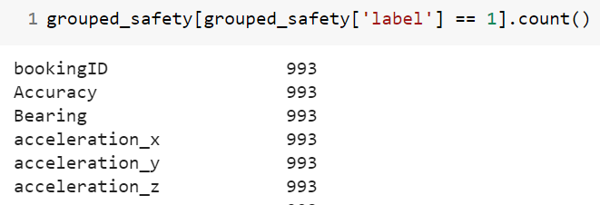
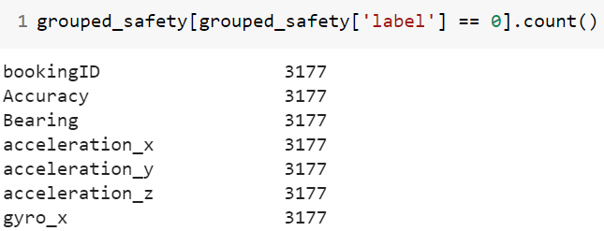
Model Building
StandaradScaler is used to transform and standardize the data

Slide 10
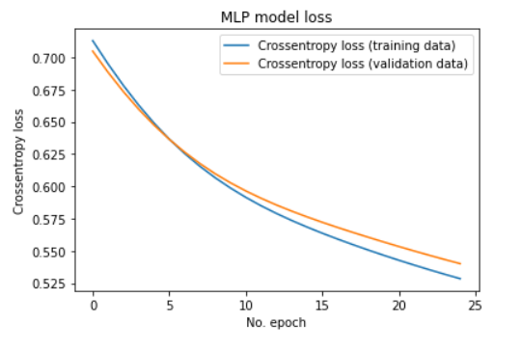
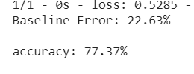
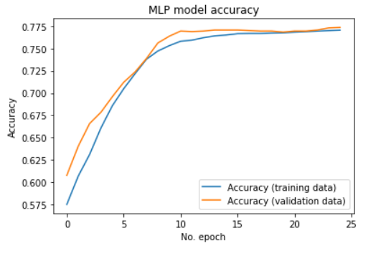
Evaluation
Baseline error: 22.63%
Accuracy of model: 77.37%
Graph of model accuracy and loss is shown

Slide 11
Conclusion
Overall, our team has found this challenge to be difficult and time-consuming. We tried our best to manipulate the large dataset and attempted the feature engineering ideas.
The accuracy score of the model is not that bad at 77%, but it is far from being a good model as the error percentage is very high, showing that the model has misclassified a lot of trips as dangerous/safe when actually, they are not

